Slide 1


Esri Redistricting Online Workshop

Slide 2

Welcome!
Intros and Expectations

Slide 3

Instructors
Mackenzie O’Brien Esri Professional Services- St. Louis
If you have any questions later, email precinct.plan@sos.iowa.gov

Slide 4
Participant Introductions
Name
Organization
Role
Experience with Redistricting/GIS

Slide 5

Zoom Meetings
Class format and how to navigate
Questions can be sent to the group chat
Set your status if you step away
Please mute if not speaking

Slide 6

Course Goals
Esri Redistricting
Module 1: Introduction
Module 2: Getting Started
Module 3: Create a District Plan
Module 4: Set Up the District Plan
Module 5: Plan Management
Module 6: Advanced Redistricting
Module 7: Sharing the Plan
Module 8: Reviewing Redistricting Plans
Module 9: Submitting the Plan
Module 10: Administration
Wrap-Up
Module Overview
Key Topics
Introduce redistricting capabilities
When to apply specific tools
Instructor Demos
See how the capabilities
Exercises
Guided exercises to reinforce concepts while you build your own district plans

Slide 7
Class Schedule
Half Day Schedule
Time | Agenda
 | Introduction to Esri Redistricting
 | Module 1: Introduction
 | Module 2: Getting Started
 | Module 3: Create a District Plan
 | Module 4: Set Up the District Plan
 | Break
 | Module 5: Plan Management
 | Module 6: Advanced Redistricting
 | Module 7: Sharing the Plan
 | Module 8: Reviewing Redistricting Plan
 | Module 9: Submitting the Plan
 | Wrap-Up

Slide 8
What is Esri Redistricting?
Increased collaboration between government and citizens
Enterprise
Integration
Browser-based software for web GIS
Facilitates collaboration, sharing and community building
Intuitive interface
No GIS experience required
Connects legislators, professionals and the public in the redistricting process
Provides transparency
Public
Engagement
Advocacy Groups
Web GIS
Legislature Staff
ArcGIS
Notes:
Esri strongly supports connecting citizens and the government during the redistricting process in order to encourage transparency.
We want for the software to be easy for both GIS professionals and those without GIS experience to work with.
We provide transparency by allowing for it to be easy to see who is doing what and when.

Slide 9
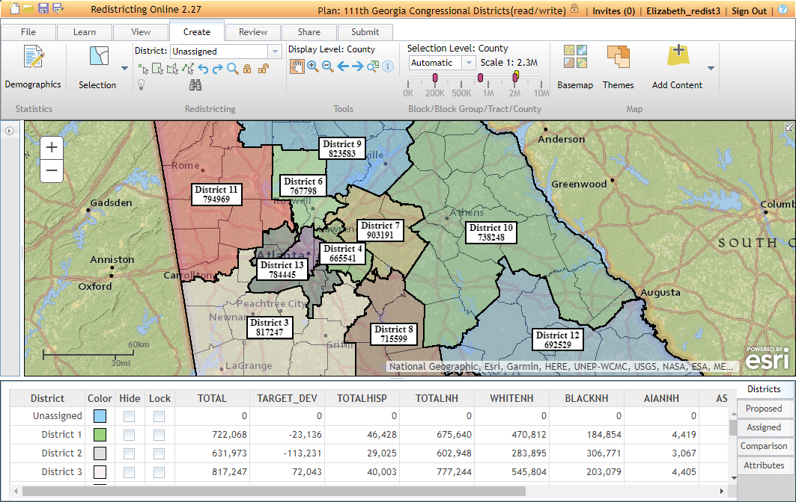
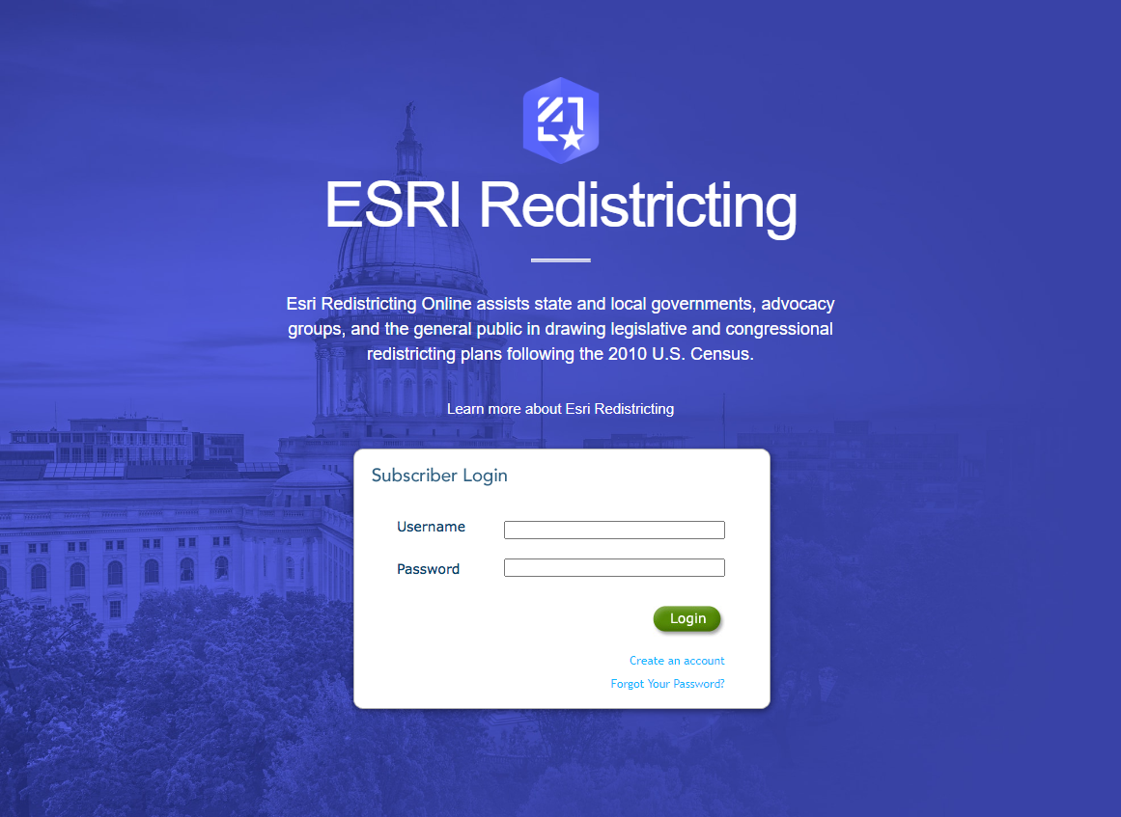

Application Overview

Slide 10
Getting Started

Slide 11
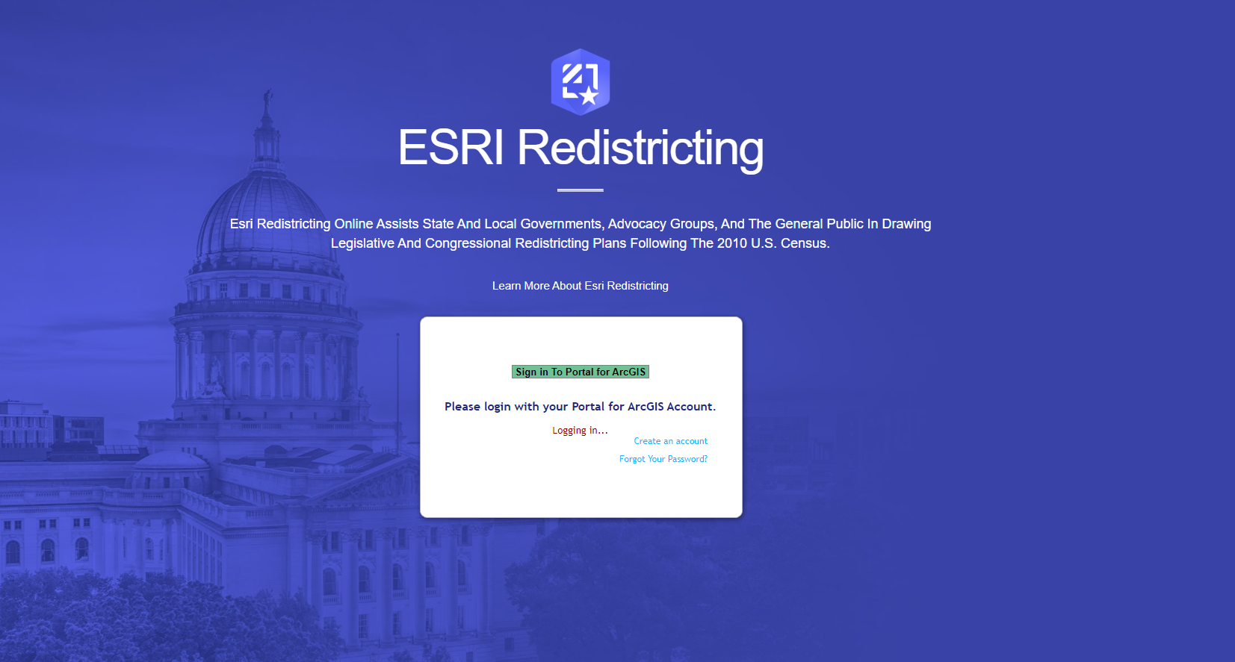
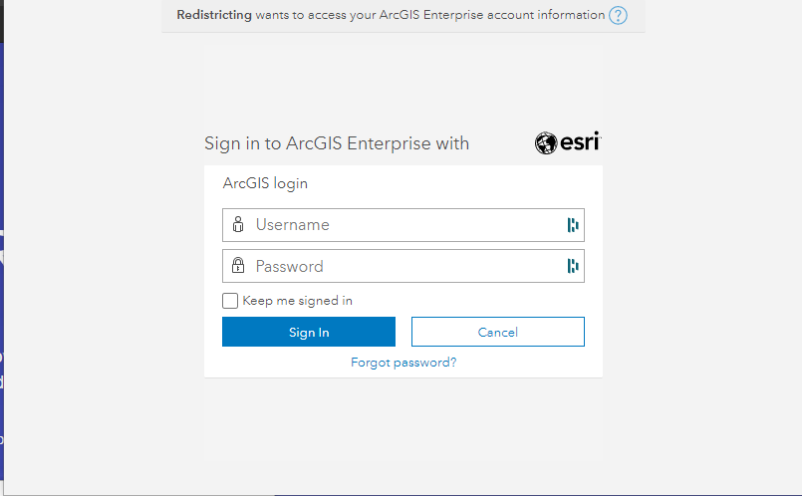
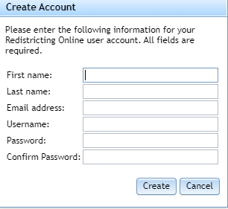

Slide 12
Exercise: Logging Into the Application (5 mins)
Username is first initial + last name + 21 (example: jdoe21)

Slide 13
Create a Plan

Slide 14
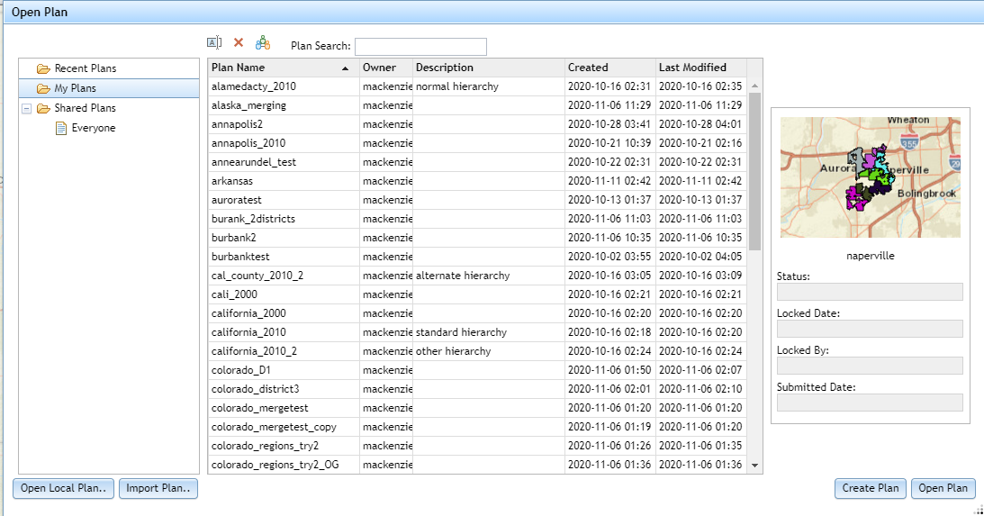
Creating Plans
Open Plan dialog
Recent plans
Plans you have opened lately
My plans
Plans you have created
Shared plans
Plans shared with groups that you are a
member of or plans shared with everyone
Users also have the option to bring in existing local plans and import plans
Notes:
Elaborate on what kind of plans can be imported (what file types, block equivalency file & Shapefile )

Slide 15
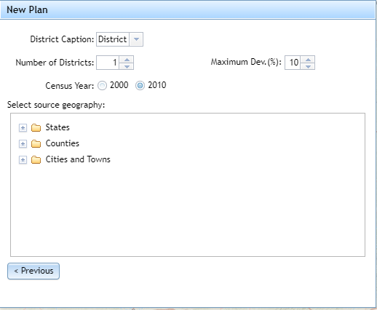

Nom
Nomenclature change
Can be changed later
Cannot be changed from within a plan

Slide 16
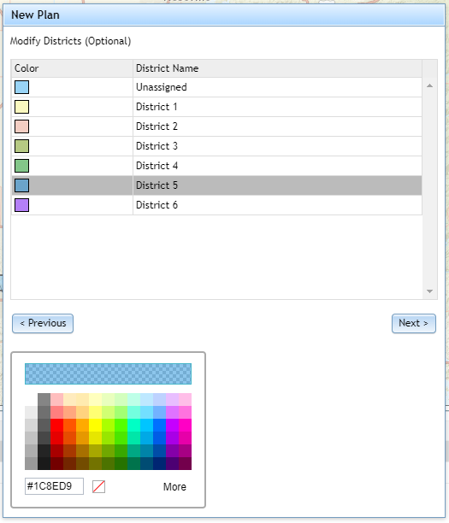
Colors can be changed by clicking on the tile

Slide 17
Instructor Demo
Notes:
Create Plan: Arkansas, 2010, 2.
Turn on Alternative and Alternative VAP (Sum/Percent)
Create Custom Variable: under alternative HPI+ASIAN
All named example
- Logging in to the application
- What do you see? Explain the layout
- How to create a plan
- How to save a plan

Slide 18
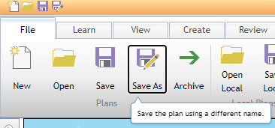
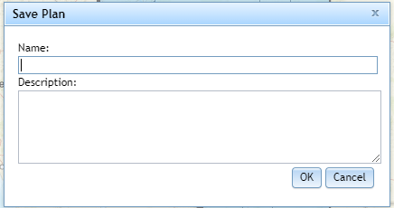
Saving Plans
Tips: Remember to save your plans frequently!
We do have auto recovery, but it never hurts to consistently save.
Description fields can come in handy when you have multiple plans with similar names
Notes:
Saving As is a good way to try out minor changes to a plan without compromising the original. Save the original, and then click Save As to make a copy of the plan under a different name.

Slide 19
Create a District Plan
Module 3

Slide 20
Create Tab

Slide 21
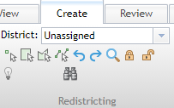
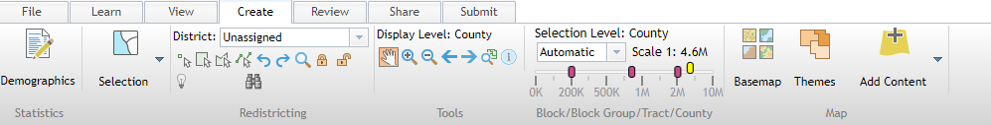
Basic Selection Tools
Dropdown menu indicates which district you are adding selected geographies to
Four drawing selection tools
Point
Rectangle
Polygon
Polyline
Allows you to lock/unlock geographies, preventing them from being changed
Notes:
It is important to ensure that the district you want to add to is selected in the drop down menu. It automatically reverts to unassigned when the application is closed, so it is always good to double check. From here, there are four basic tools to use to draw districts manually: point, rectangle, polygon, and polyline.
If you do make an error you can use the undo/redo buttons to the right of the tools. The magnifying glass will bring you to the full extent of the plan. The locks will allow you to prevent geographies blocks, tracts, etc. from being reassigned to a different district. The light bulb button is for two stage selection, which we will discuss in a bit. The binoculars help you to find unassigned geographies.
Note that clicking out of the selection tools is the way to get out of selection mode (click the hand to the right of the selection tools)

Slide 22
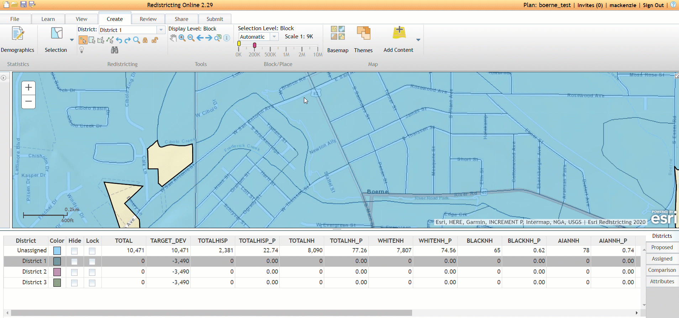
Select by Point: Good for precise selection
Subtitle
Notes:
GIF of an example

Slide 23
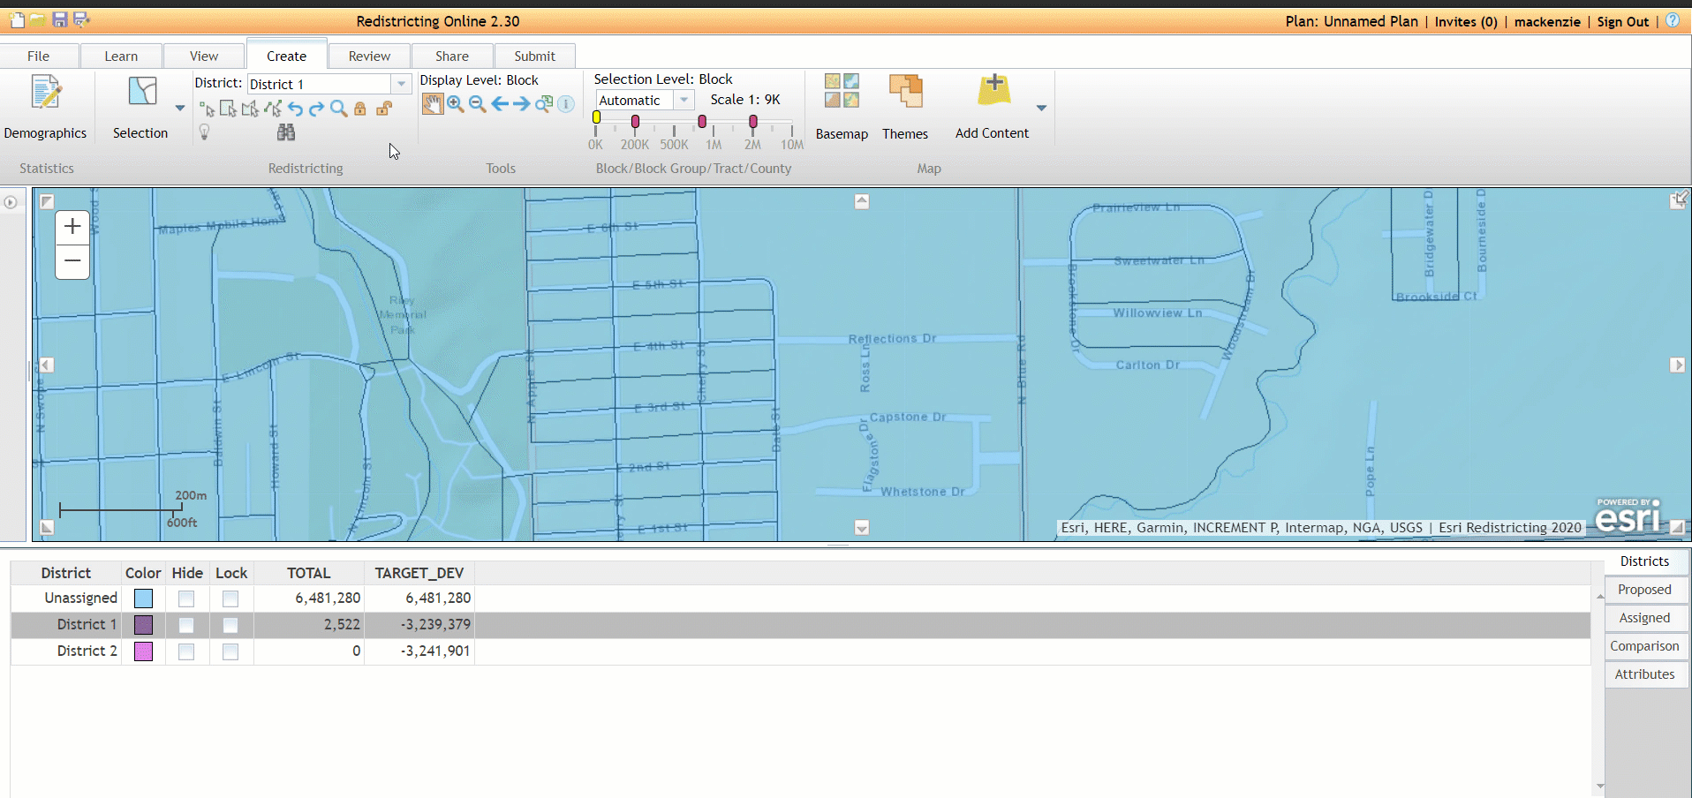
Select by Rectangle: Good for quick, imprecise selection or grid systems
Subtitle
Notes:
GIF Example

Slide 24
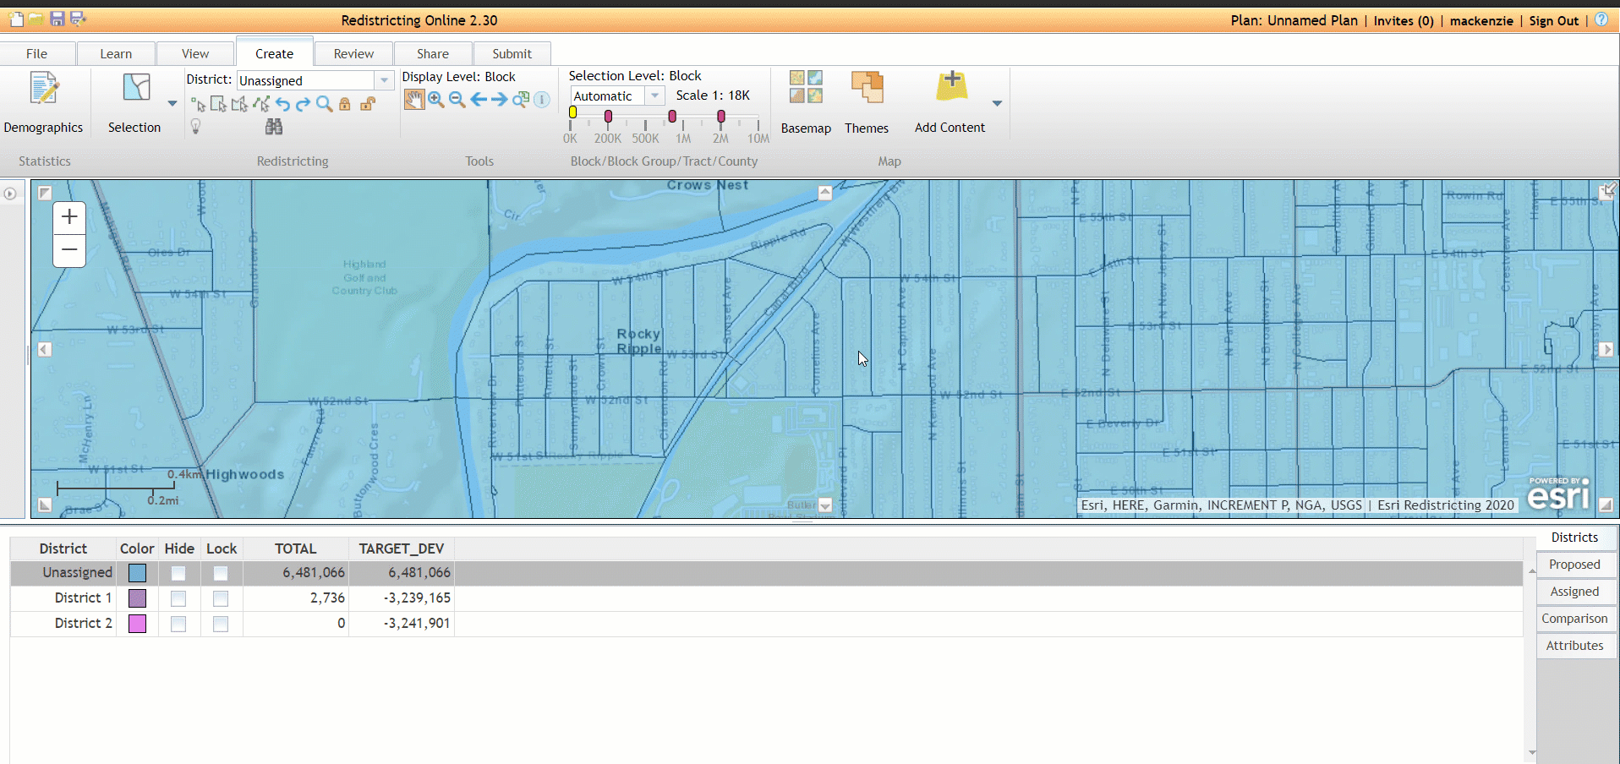
Select by Polygon: Good for selecting complicated geographies
Subtitle
Notes:
GIF Example

Slide 25
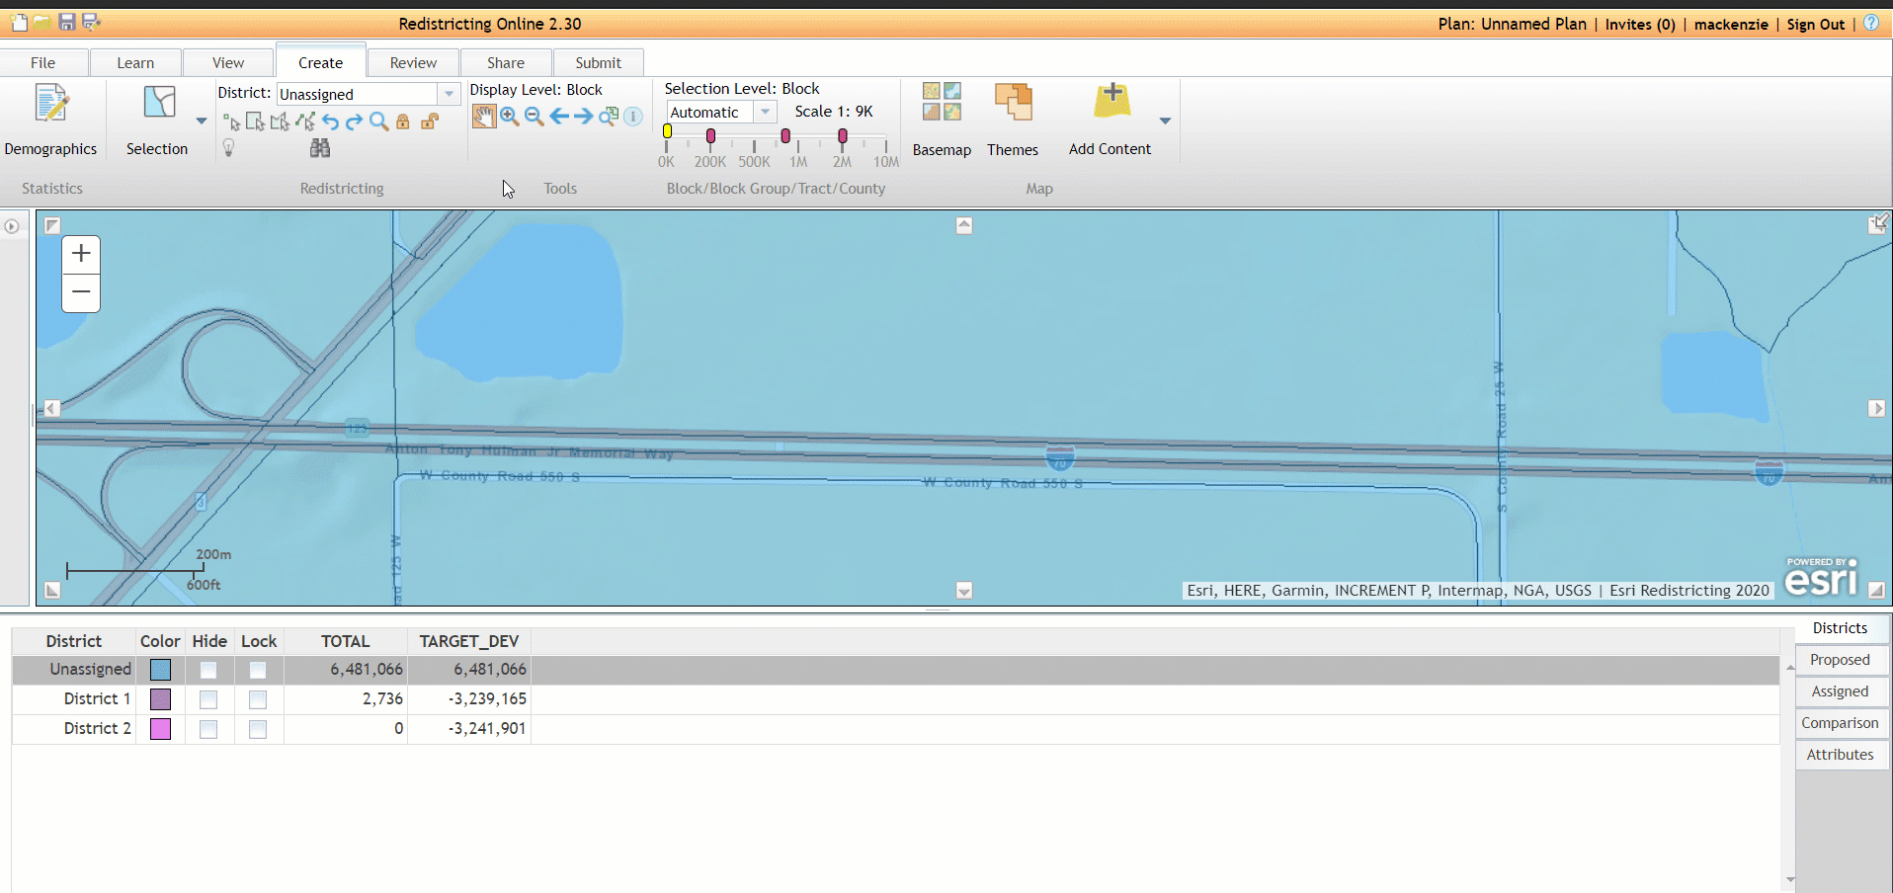
Select by Line: good for selecting geographies along roads
Subtitle
Notes:
Way to stop drawing is to double click. Clicking once will simply add another point.

Slide 26
Exercise (10 minutes)
Practice using the manual drawing tools shown in the preview on a geography of your choice
Remember to choose the district you want to assign geographies to in the dropdown menu under the create tab
Clicking once on a polygon or polyline will create a point, double clicking will end the drawing

Slide 27
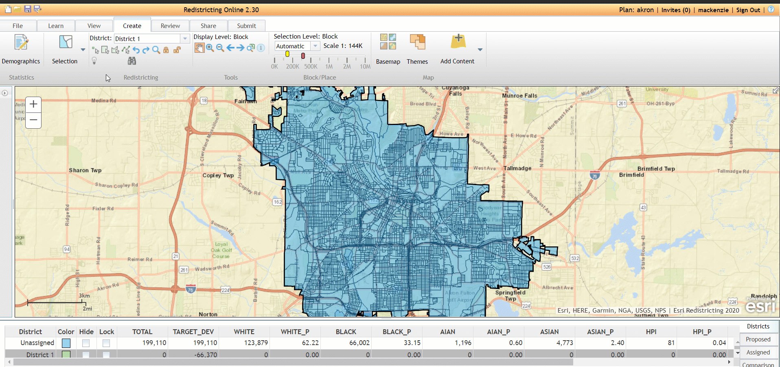
One Stage vs. Two Stage Selection
One Stage: Will automatically assign the districts meeting the criteria to the chosen district
Two Stage: Will allow you to preview before assigning geographies,
Notes:
Here’s a little preview of how the one stage vs two stage selection process works. Once I go in and write out a query, I can choose from either one stage or two stage selection. Here, I chose one stage, which is automatically set as the default. As you can see, the matching geographies are automatically added to the chosen district. Now, if I go in and write that same query, and select two stage selection, I have the option to preview what that assignment would look like before assigning them or choosing not to via the lasso or the red x.
Includes GIF previewing the functionality

Slide 28

One Stage vs. Two Stage Selection
Exit two stage selection
Assign the selection
Find Unassigned geographies
Zoom to current selection
Toggles on two stage selection
Notes:
Note that you can use two stage selection with any form of selection method. Also that one stage selection is default.

Slide 29
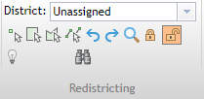
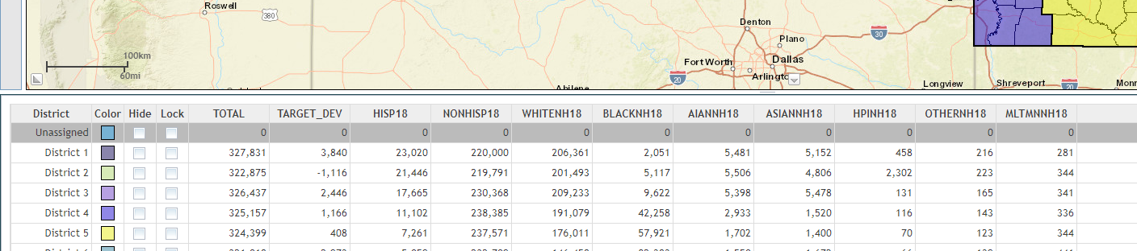
Lock/Unlock Geographies
Two ways of locking geographies
Locks/unlocks individual geographies by clicking on them
Locks/unlocks districts assignments as a whole
Notes:
Using the lock symbols allows for you to lock individual geographies like tracts/counties from being changed to a different district assignment.
Using the lock check boxes in the district window allows for you to ensure that geographies assigned to that district cannot be moved to another one. Also prevents new geographies from being added to the district when locked. We’ll talk a little more about the district window in the next slides.

Slide 30
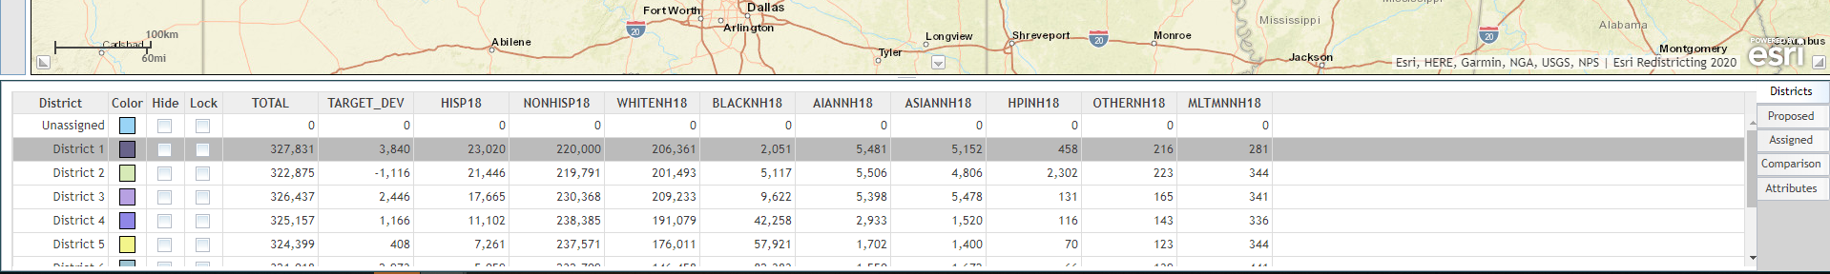
District Window

Slide 31
District Window
Temporarily hides the district on the map
Allows for color toggling
Notes:
Note that the demographic numbers in the table adjust as you update assignments.

Slide 32
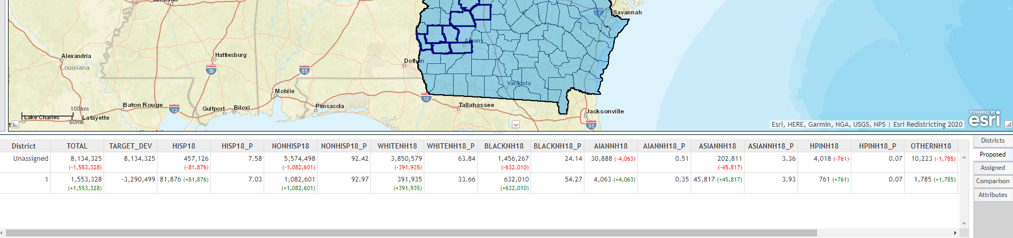
District Window
Proposed Tab shows how demographics would be different if two-stage selection is assigned.
Red= decrease, Green=positive
Notes:
If you have two stage selection enabled, and some geographies selected but not assigned yet, this window will show you how the demographics of the involved districts would change if you were to choose to assign the geographies.

Slide 33
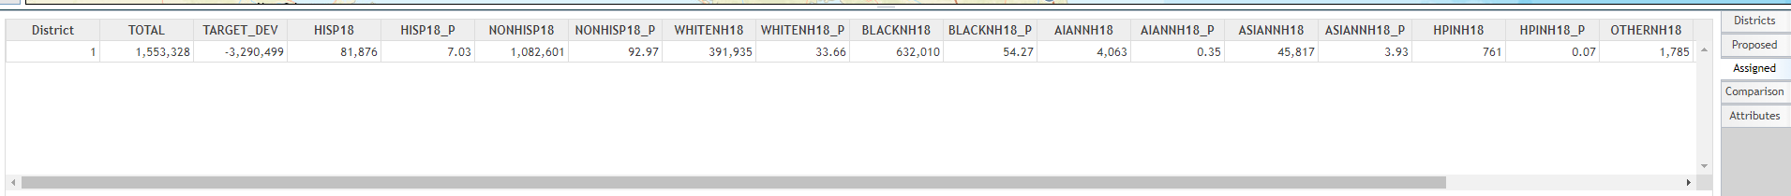
District Window
Assigned tab shows similar information as proposed, but without the change indicators
Notes:
The assigned tab shows how the chosen district would look if the two stage selection were enacted, but no other information about other districts.

Slide 34
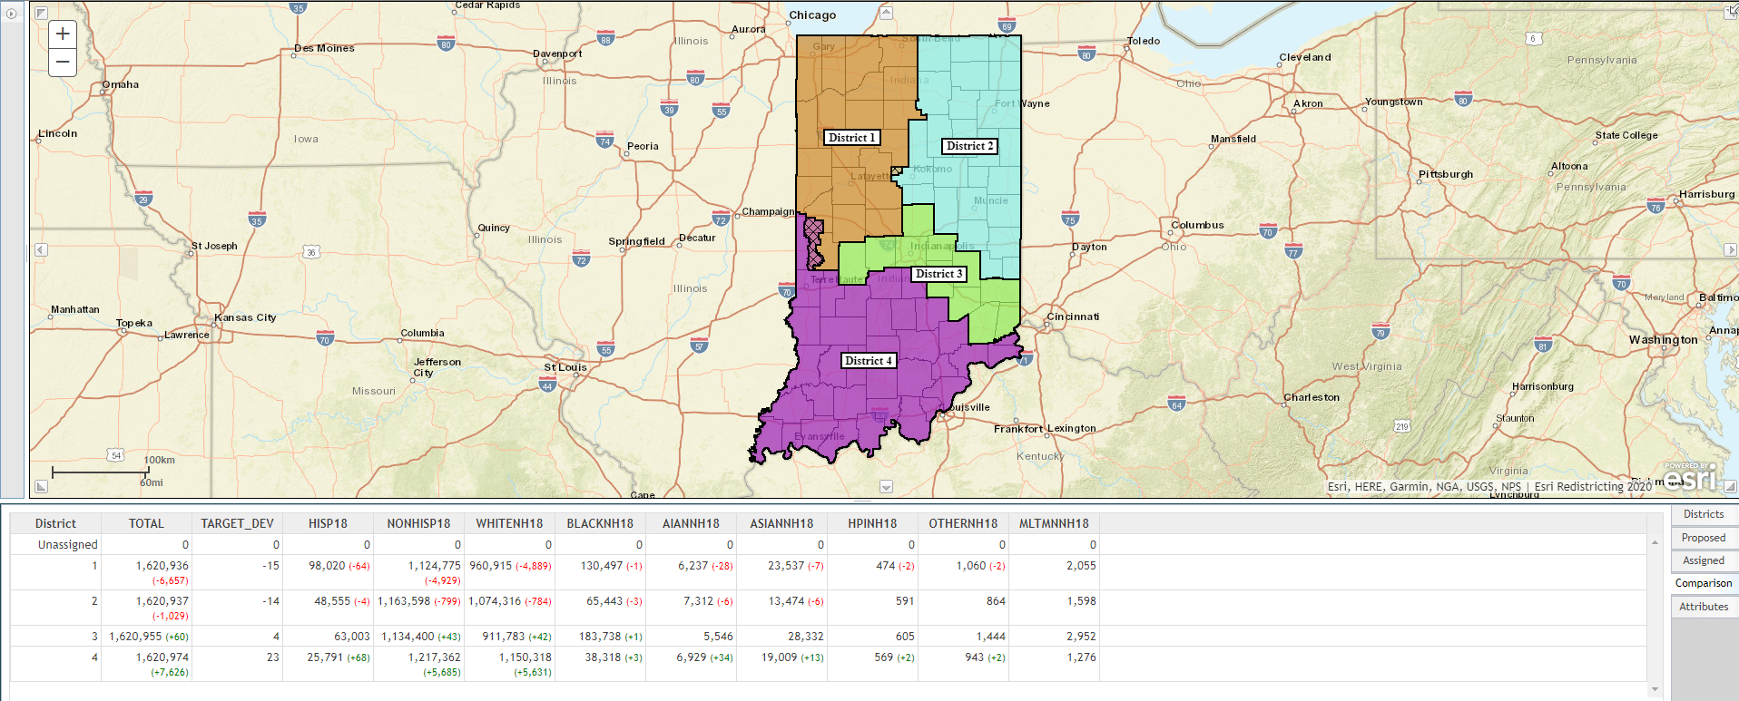
District Window
Comparison tab shows differences between active plan and plan brought in for comparison (we will demonstrate how to do this later!)
Notes:
When bringing in two plans to compare, you can use this window to visualize how the two plans vary demographically from one another. This only works if sum variables are in use. It does not work with percent variables.

Slide 35
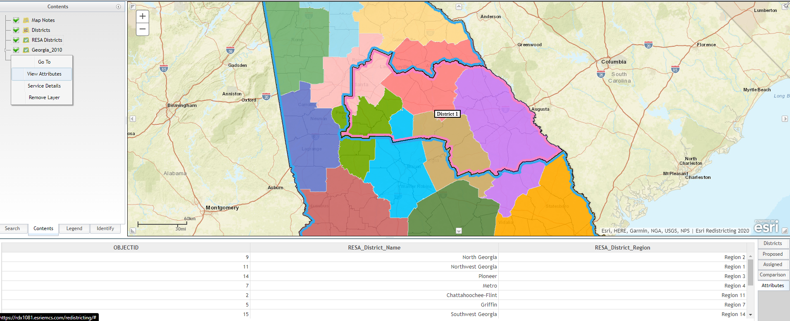
District Window
Attributes tab pulls up attributes for external layers, accessed by the contents pane.
Notes:
If you bring in an external layer to use as reference, you can use the contents pane to bring up the attribute table of the external layer.

Slide 36
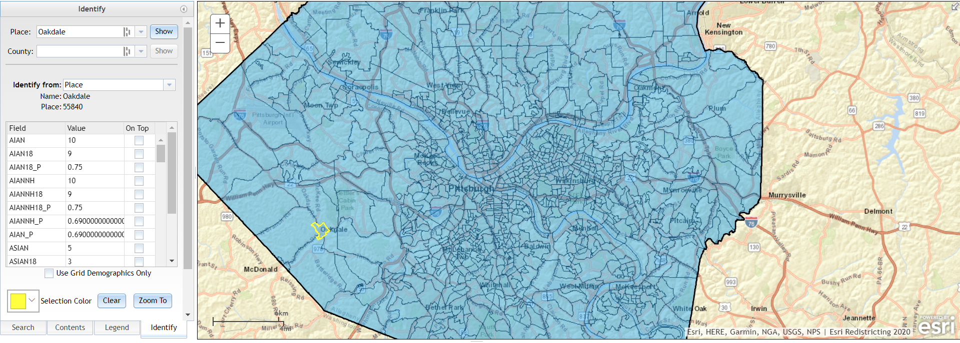
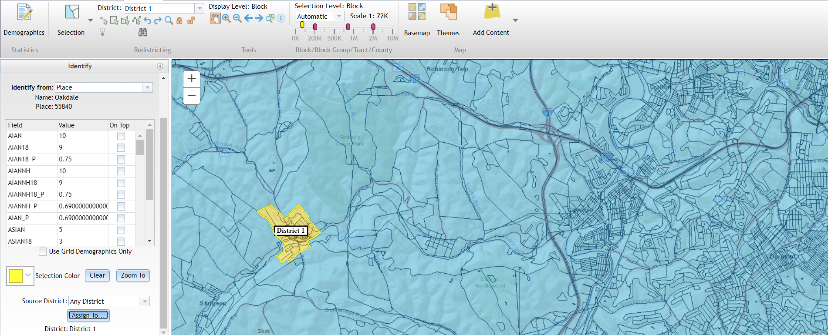
Identify By Census Geographies
Notes:
If you want to add the entirety of a census designated place or a county to a district, you could use this functionality. Helpful if you want to ensure a particular town or county is not split among two districts.
You simply select the district you want to assign the place/county to, open the left hand panel to identify, choose the place/county, scroll down and hit assign to.

Slide 37
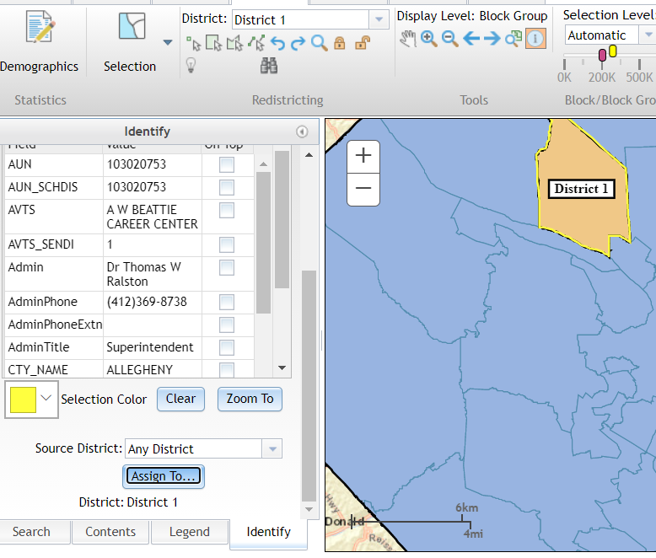
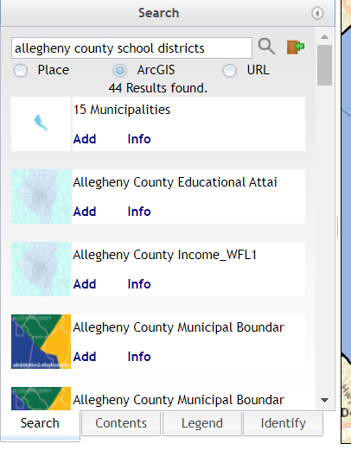
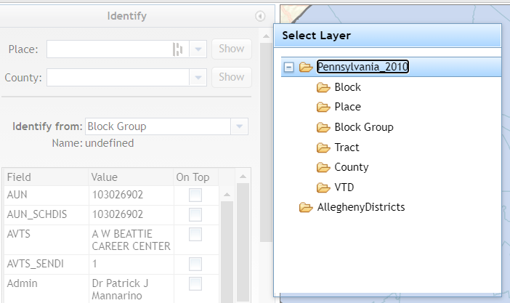
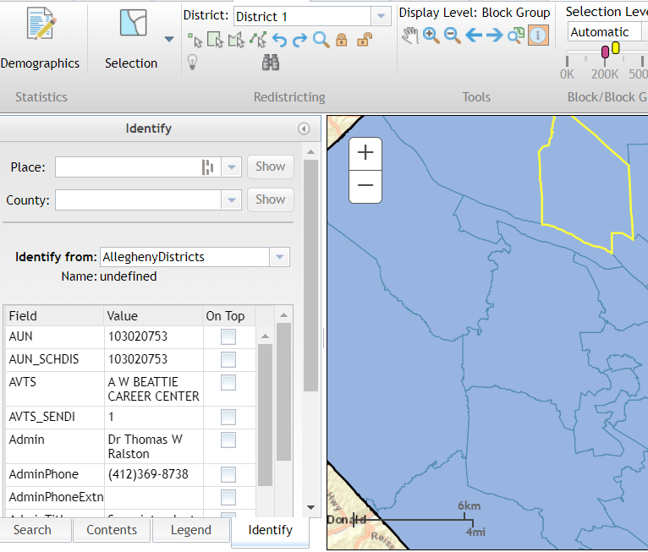
Identify/Select By External Source
Bring in a layer from ArcGIS online or a REST Endpoint
On the Identify tab, choose to identify from the layer
Use the identify button to select the location you want
Ensure the desired district is selected and click Assign To
Notes:
You can also bring in external layers and assign geographies that overlap with that layer to districts. As always, you start by choosing the district you want to assign the geographies to in the create tab. You bring it in via the search panel, which we will touch upon more later in the course. Then you switch over to the identify pane and choose the layer you brought in from the identify from dropdown, use the identify button (highlighted in green) to click on the area you would like to bring in, and then scroll down and select assign to.

Slide 38
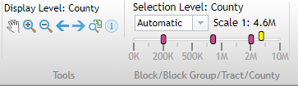
Map Navigation
Notes:
While the navigation can be a bit hard to get used to at first, once you play around with it, it becomes more intuitive. The red bars represent the geography levels written below it. You can adjust them to fit the scale you would like to see particular geography levels at at different extents. The yellow bar represents the scale the map is currently at. The hand allows for you to pan around the map, the magnifying glasses allow for you to zoom, the arrows go to extents you were previously at, the magnifying glass with a map brings you to the full plan extent, and as we discussed earlier the I button allows for you to identify a feature.

Slide 39
Basemaps

Slide 40
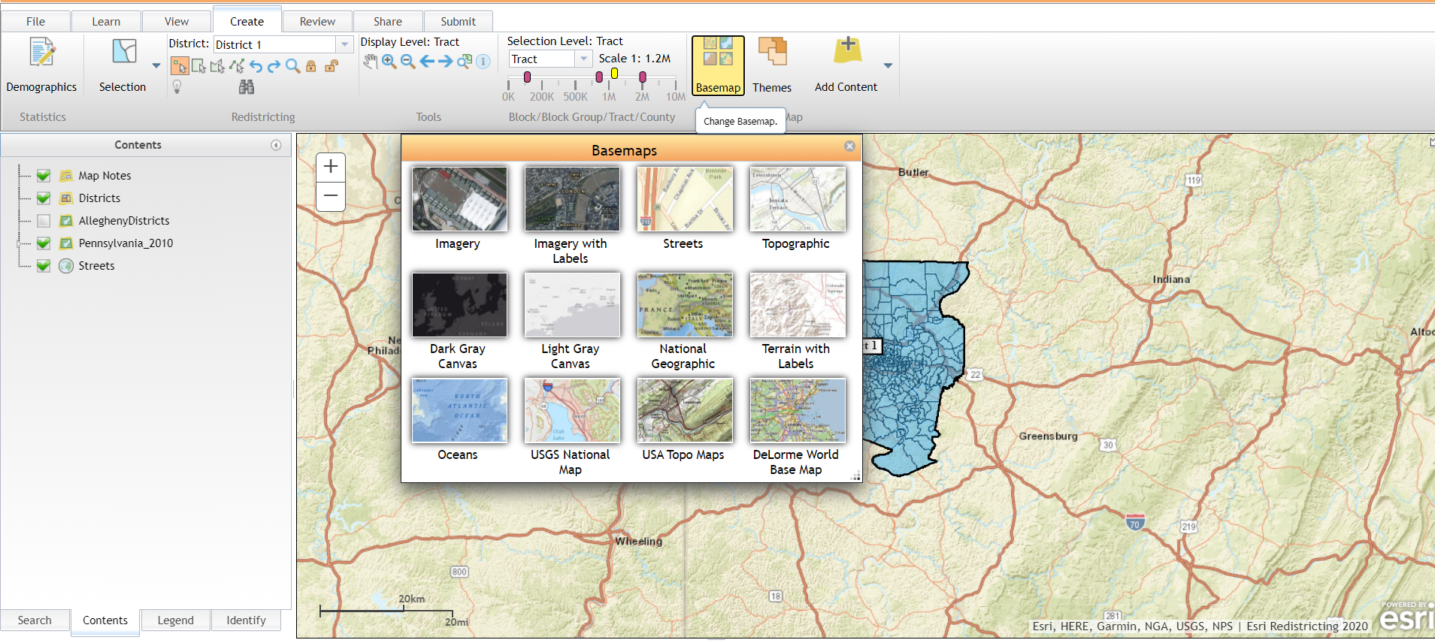
Basemaps
Notes:
Basemaps are the standard ones used in AGOL, additional ones can be added to the gallery by the admin.

Slide 41
Instructor Demo
Notes:
Demo:
- One and Two Stage Assignments (Bexar Demo Plan)
- Identify by external sources
- Selection/visualization level

Slide 42
Exercise (15 mins)
Use the Basic and Advanced Selection Tools to Assign Geographies to a Plan
Make a selection using the basic selection tools
Point
Rectangle
Polygon
Line
Assign geographies using one-stage and two-stage assignments
Assign by census geography (add an entire city/town to a district)
Work with external layers
Add an external layer (Linn County School Attendance Areas)
Identify from the external layer and make an assignment
Change the basemap
Test Area: Linn County
Layer to Use: Can also be accessed by searching Linn County School Attendance Areas
Don’t worry about making the plans balanced or similar to existing plans, we just want to practice using the tools!

Slide 43
Set Up Your District Plan
Module 4

Slide 44
View Tab

Slide 45
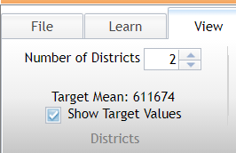
Change the No. of Districts / Target Values
Shows the “ideal” number of people per district in the attribute table, if you want them to be equally balanced.
Can be adjusted on the fly, as long as you do not decrease the number of districts after you have made more than your desired number. (ex. If you have already made 10 districts, you cannot decrease to 9 districts. You must unassign all the geographies in that district in order to decrease the no. of districts to 9

Slide 46
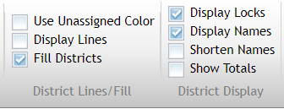
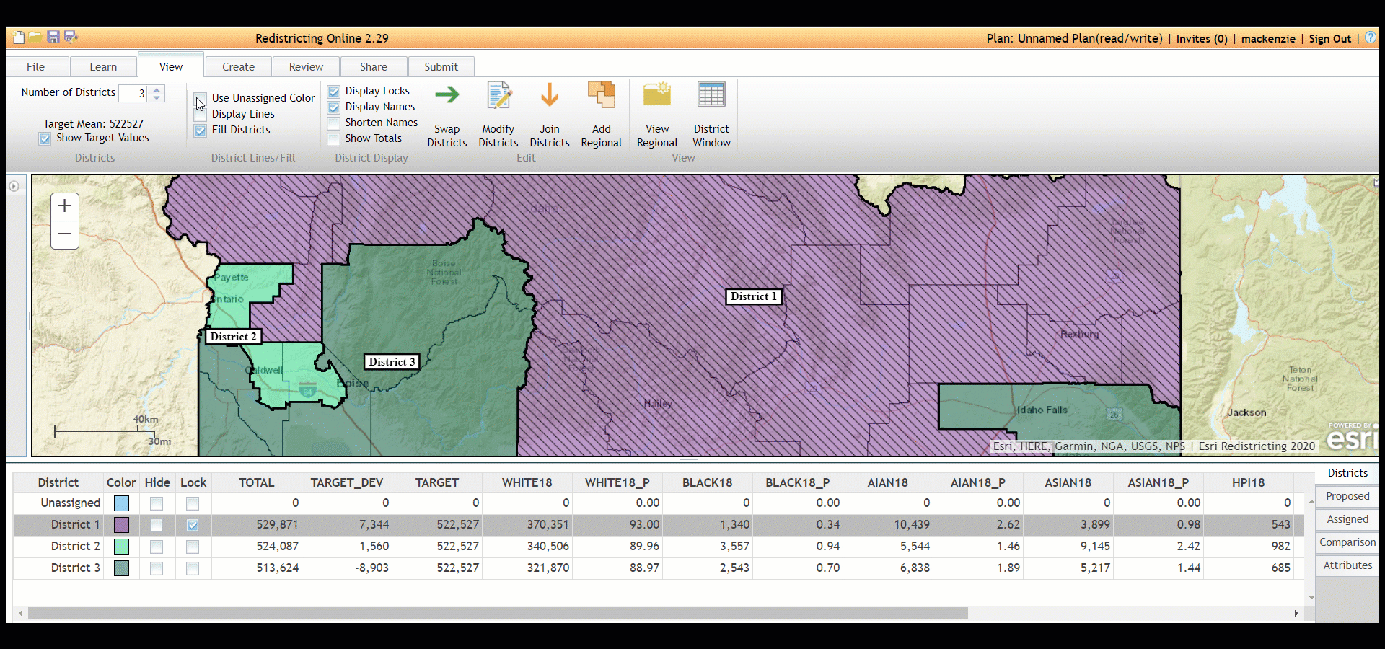
District Lines/Fill & District Display
Notes:
GIF goes in order
Unassigned color makes all the districts appear the same color
Display lines removes the fill from the districts
Fill districts fills the district with the chosen color
Display locks shows which geographies are locked from having their assignment changed
Display names shows which district is which
Shorten names labels them with their short name
Show totals shows how many people in each district.

Slide 47
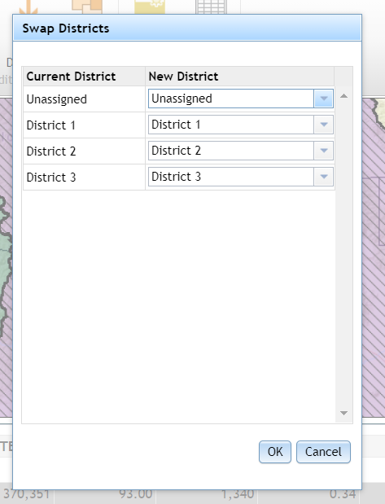
Swap Districts
Allows you to change the placement of the districts, but will not change the underlying geography.
For example, perhaps you have created a plan where District 1 is on bottom, but needs to be on top. You can simply use this dialog to switch the names of the two districts to align with your needs.

Slide 48
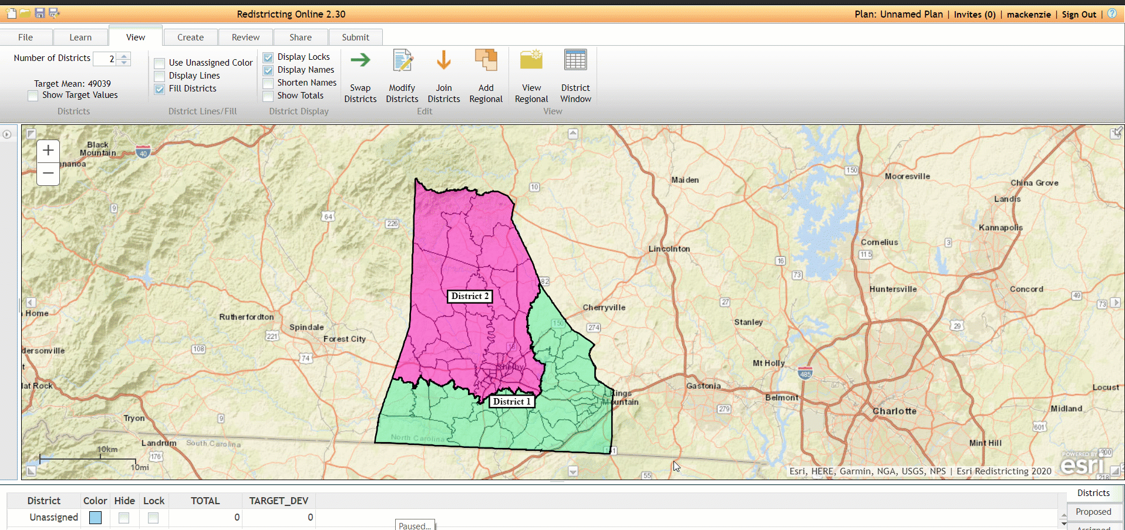
Swap Districts
Notes:
GIF demonstration

Slide 49
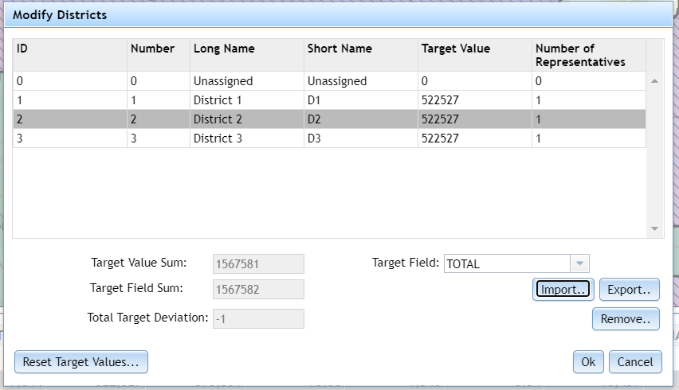
Modify Districts
Any of the below fields, except for ID, can be manually changed.
Changing No. of Reps will update the target value once you hit reset target values
Can be changed to any demographic field
Notes:
Elaborate on the Target Field drop down, that users can change the census field from which the Target values are derived
Explain the number of representatives and the impacts of updating

Slide 50
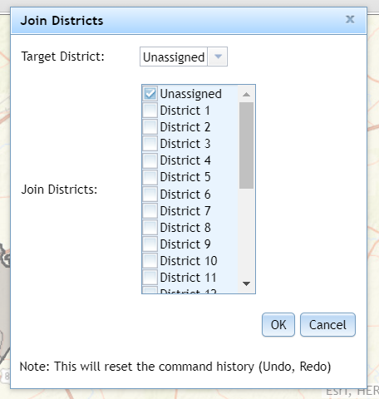
Join Districts
Allows for you to combine multiple districts into one or revert them to unassigned
Good for combining smaller districts into larger districts (ex. Merging elementary school attendance zones into middle school attendance zones)

Slide 51
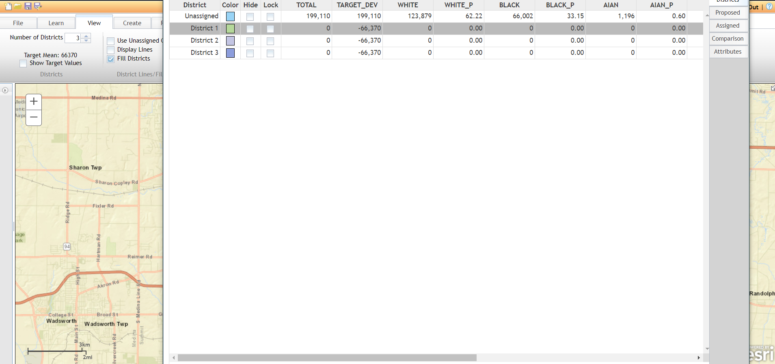
District Window
Allows for you to pop the district window out and bring it into another screen

Slide 52
Instructor Demo
Notes:
Demo of:
Join
Regional (plan division and merge workflow)
District Window

Slide 53
Break
15 minutes (return @2:35)

Slide 54
Plan Management
Module 5

Slide 55
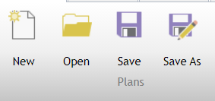
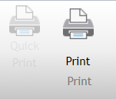
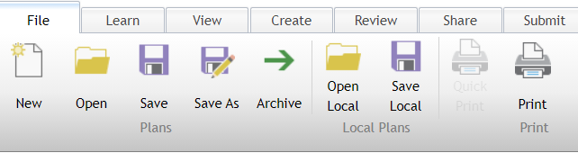
Organization Functionality / Print Demo
Notes:
Demo creating new plan, opening existing plan (reminder of group sharing and search functionality), save functionality (brief mention of autorecovery), save as saves plan under different name
Explain the Open Plan dialog (ex. organizing plans, folder structure, preview, locked plans, search plans, shared plans)

Slide 56
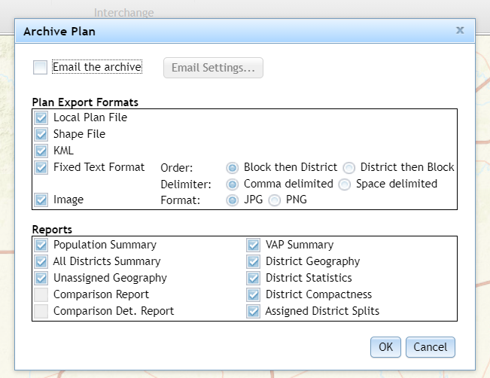
Archive
Notes:
Produces a zip file with all of the files of your choice, also allows for email. Good for sending out multiple files without manually adding them to a folder yourself.

Slide 57
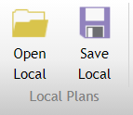
Open / Save Local
Good for sharing plans between users of different organizations
Allows you to save the plan locally to your computer and open it
Notes:
Saves it as a .plan file to your computer, so you can send it to others.

Slide 58
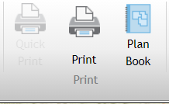
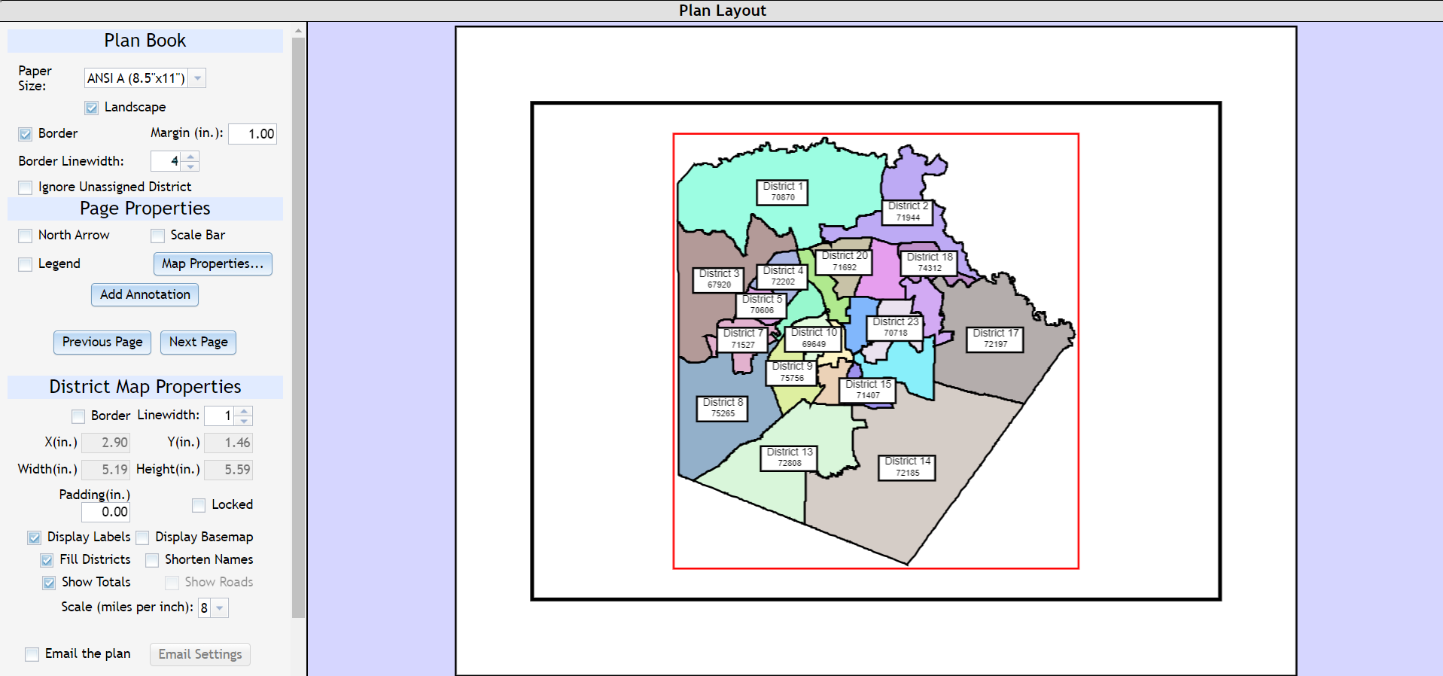
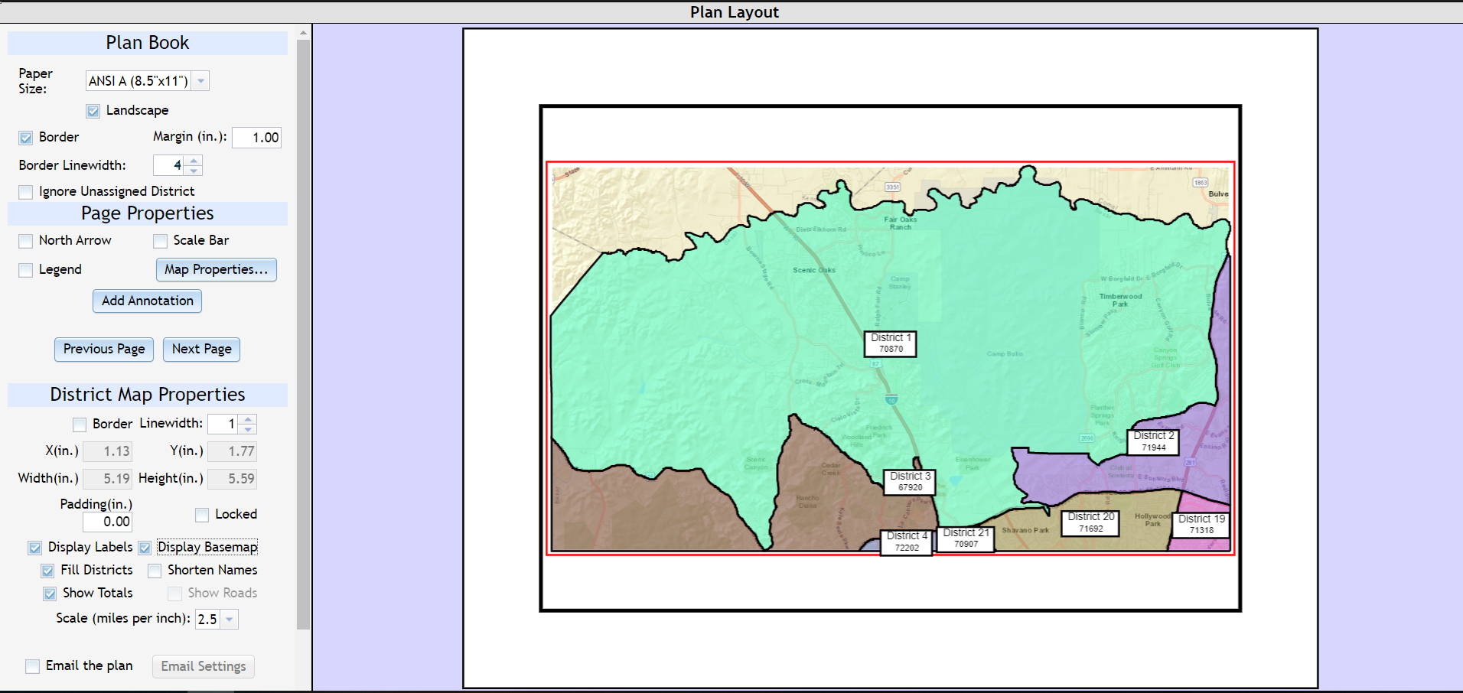
Plan Book
Creates a separate page for each district
Allows for customization for each page
Notes:
Creates a unique page for each district and allows for each one to be customized to your liking with basemaps/orientation/scaling/etc. Downloads as a .pdf

Slide 59
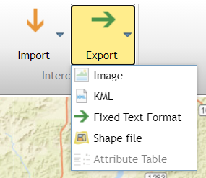
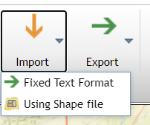

Import / Export
Notes:
Import adds a shapefile or fixed text format as a new plan. Import and Export are different from Add Content!! Add Content adds reference layers

Slide 60

Share Tab

Slide 61





Plan Information
Notes:
Attachments is a good place to attach word files with reasoning behind decisions or in depth analysis, plan information is a good place for adding basic information, comments are good for giving your thoughts on other people’s plans, access log allows you to see who has accessed the plan and what they did to it.

Slide 62

Edit Profile
You are allowed to change all fields except for username at any time.
Multiple accounts can be made under the same email address if needed.

Slide 63
Advanced Redistricting
Module 7

Slide 64
Adding Content

Slide 65

Search ArcGIS Online

Slide 66

Adding Content from ArcGIS Online
Log in to ArcGIS Online to access your personal and group content
Log into your AGOL account (brown door icon)
Search for content
Search results return:
Content that is private to you or your organization
Public facing content
Notes:
Again, reiterate that using the brown door symbol allows you to go into your own AGOL

Slide 67



Search ArcGIS Online by Keyword(s)
Tip: Specify your search from the beginning!
Notes:
Again, reiterate that using the brown door symbol allows you to go into your own AGOL

Slide 68


Working with ArcGIS Online Layers
You can customize symbology of feature services, but not map services
Zooms to the full extent
Pops open the attribute table of the layer
More information on the service
Removes layer from the map

Slide 69

Working with Locations
Must be in Excel Spreadsheet
Supports locations in two formats:
XY
Address
Multi-line
Single-line

Slide 70


Working with Locations
Notes:
Can either use multi line or single line address format

Slide 71



Working with Locations
Tip: If the map is too “busy”, toggle items on/off in the contents pane
Notes:
Can either use multi line or single line address format

Slide 72



Working with Shapefiles
Notes:
Mention that all shapefile types are supported (Points, Lines, Polygons), but must be a ZIP with all supporting files

Slide 73
Instructor Demo
Notes:
Demo the following capabilities:
* Search and Add Content from AGOL
* Add Locations
* Add Shapefile

Slide 74

Exercise (20 mins)
Scenario: Iowa is looking to some redistricting and needs help bringing in reference layers in some different formats.
Create a new plan for Linn County or continue from your last one
Use the skills you have learned in the last slides to bring in these datasets:
Search ArcGIS for Iowa School Districts
Add the Political Townships Shapefile
Add the LinnCoColleges Excel sheet
Save your plan
You do not have to make districts, but if you have extra time and want to practice making districts, go for it!

Slide 75
Reviewing Redistricting Plans
Module 8

Slide 76


Check Integrity
Integrity Check | Check Description
Dual Assignment Check | Verifies that a geography is only assigned to one district.
Population Summary Check | Ensures that the total population count in all districts is equal to the whole area.
District Count Check | Ensures that all districts have at least one assignment.
Maximum Deviation Check | Verifies that each district deviation does not exceed the maximum deviation.
Null Assignment Check | Ensures that there are no unassigned geographies in your district plan.
Connectivity Check | Ensures that all parts of a district are connected with the rest of the district.
Notes:
GIF

Slide 77

Maximum Deviation Error
If your plan fails the maximum deviation check, you can:
Increase the maximum deviation by clicking details (not recommended), or
Return to the plan and rebalancing the districts

Slide 78

Null Assignment Error
If your plan fails the null assignment check, you can to zoom to the area(s) that are unassigned
Notes:
GIF

Slide 79

Connectivity Error
If your plan fails the connectivity check, you must reassign the disconnected geography to the rest of the district. This doesn’t apply to geographies (such as islands) that are disconnected from the rest of the district.
Notes:
GIF

Slide 80
Reports

Slide 81

Reports
Report Title | Report Description
Population Summary Report | Calculates the working census demographics by geography (for example, districts, precincts, or territories).
All Districts Summary Report | Shows the total population, demographics, and voting age population for each district.
Voting Age Population Report | Displays the voting age population (for example, all persons 18 years or older) in each district.
District Geography Report | Shows the total population of each geography in the plan, using the Federal Information Processing Standards (FIPS) code.
District Statistics Report | Displays the total population and demographic information by district.
Unassigned Geographies Report | Generates a statistics table that contains the total population of unassigned geographies in each county of the district, divided into the Federal Information Processing Standards county code.
Comparison Report | Displays differences between the active plan and the compared plan. This report is only available if you have both an active plan and a compared plan open.
Comparison Report Detailed | Displays total differences for each district across the active plan and the compared plan. Differences include the total blocks and demographic values. This report is only available if you have both an active plan and a compared plan open.
Bill Text | Displays the smallest geography level by district and unassigned geographies. Bill Text reports can only be generated to XML and HTML formats.
District Compactness | Generates a statistics table that contains the compactness of the district.
Assigned District Splits | Lists each county or precinct that is included in a district. Counties that are split (overlap) multiple districts are denoted with an asterisk (*).
Metes and Bounds | Lists each district boundary using metes and bounds, a surveying method in which the limits of a parcel are identified as relative distances and bearings from landmarks. The metes and bounds report describes the district boundaries using TIGER/Line ID (TLID). Metes and Bounds Reports are generated with HTML/XML formats.

Slide 82


Report Format
Reports can be generated in PDF, Excel or HTML
Can change title of report
Metes & Bounds and Bill Text have different formats, as seen below
Lets you use % instead of raw values
Allows you to email a report to recipient of your choice, can change message text under email settings
Open folders to add variables, click on fields on the right to remove from the report
Notes:
Mention the limitations on report fields based on the report type

Slide 83
Comparing Plans

Slide 84


Comparing Plans
To visualize the difference between two plans, use the plan comparison to see differences
Sliders can be used to adjust transparency
Merges differences
Hatched areas indicate geographies assigned to different districts in the two plans
Shows differences between plans in numerical format

Slide 85


Map Notes
Map Notes are useful in pointing out areas of interest and writing notes on the map. They can be particularly useful in making notes when comparing maps.
Right click to edit

Slide 86
Instructor Demo
Notes:
Demo:
- Charts
- Compactness Tests
- Integrity Tests (with some error reporting)
- Reports
- Plan Comparison
- Map Notes

Slide 87

Exercise (40 mins)
Scenario: We want to break Linn Co into three districts, similar to the one to the right. The Target Deviation should be no greater/less than +/- 200 people.
Create Linn Co Plan:
2020 data
3 Districts
1% Maximum Deviation
Run Integrity Tests, make sure plan passes all 6
Share Plan in a group with colleague(s)
Use Plan Comparison Tool to view differences
Run Reports
Comparison Report
Comparison Report Detailed
Make a comment on your colleague’s plan describing differences between your plans
Save your plan

Slide 88

Submit Tab

Slide 89





What Happens When I Submit a Plan?
Integrity tests are run and must be passed
Must provide contact information
Reminded that you cannot change once submitted
Sent to reviewer group
Notes:
Note that they can Save As to edit a plan after submission

Slide 90

RXO_SubmittedPlans
All submitted plans go to the RXO_Submitted Plans group, shared to all admins
Can run any reports, view any graphs, view attachments
Plans can be ‘saved as’ if you wish to make any edits

Slide 91
Course Review
Introduction to Esri Redistricting
Lesson 1: Introduction
Lesson 3: Create a District Plan
Lesson 4: Set Up the District Plan
Lesson 5: Plan Management
Lesson 6: Advanced Redistricting
Lesson 7: Sharing the Plan
Lesson 9: Submitting the Plan
Wrap-Up
Lesson 2: Getting Started
Lesson 10: Administration
Lesson 8: Reviewing Redistricting Plans
What did we cover?
You should be able to:
Create a new district plan
Assign geographies
Review the plan
Run quality checks on the plan
Save and Archive the district plan
Submit the plan

Slide 92

Key Takeaways
Redistricting is an iterative process
Thoughtful, balanced redistricting plans take time
Input and feedback from others are important
Data that supports requirements and audits
Census data integration
Creates regulation-compliant redistricting plans
Built-in tools to check for integrity, compactness, reports
Transparency
Enables government, advocates, and citizen involvement
Documenting who did what and when
Bringing clarity to the redistricting process

Slide 93
Resources
Where to find additional redistricting information?
Blogs
What’s new in Esri Redistricting?
What you need to know about Redistricting – Industry Blog
Videos
Delivering a Modern Redistricting Solution Recorded Webinar
Esri Redistricting YouTube video tutorials
Tutorials
What is Redistricting? – Esri Storymap
Learn Lesson w/ Trial software
Documentation
What is Esri Redistricting? – Documentation
Understanding Demographic Variables – Documentation
ArcGIS Hub Resources
Sample ArcGIS Hub site with Redistricting content
Colorado use-case with Esri Redistricting + ArcGIS Hub?

Slide 94
Feedback
How did we do?
Please fill out our Survey123 to help us improve the course for future offerings: https://arcg.is/19O4v0

